Slide 1

By:
Fernando Nuno Vieira
Loz Rigby
Nour Kashto:

Slide 2
Contents
Introduction
Data cleaning and tokenisation
Traditional NLP and ML approaches
Transformer Approach
Seq2Seq Model
Summarization

Slide 3

Introduction:
Project overview:
The primary objective of this project is to develop intelligent system that can automatically classify customer reviews and extract key insights to inform strategic decision-making.
3 different model was tested to deploy the most efficient one
An summarization model was built to help summarize customer review
Main tools:
Python
Google Colab
Transformers
Torch
NumPy
Pandas
Seaborn
Dataset:
The dataset used for this project was provided by Datafiniti's Product Database, capturing various attributes such as product information, rating, and review text.
34,660 row
21 columns
41 product categories

Slide 4
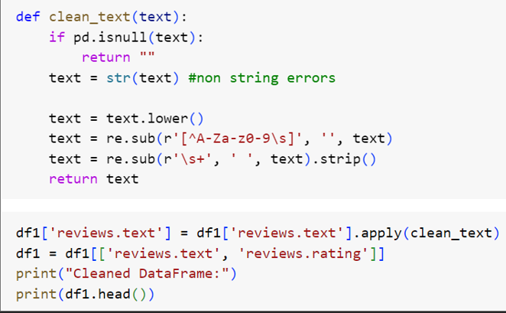
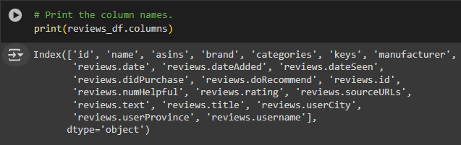
Data Exploration and cleaning: similar step were taken for all 3 text classification models.
It’s important process for the following point:
Data exploration is a fundamental phase in the data analysis process, as it enables us to thoroughly examine and comprehend the dataset we will be working with. This critical step provides valuable insights into the structure.
With text data, it's important to clean the text from special characters, punctuation, white space, and organize it well to get it ready to be fed to the model.
NLP models perform better on clean, well-structured data.

Slide 5
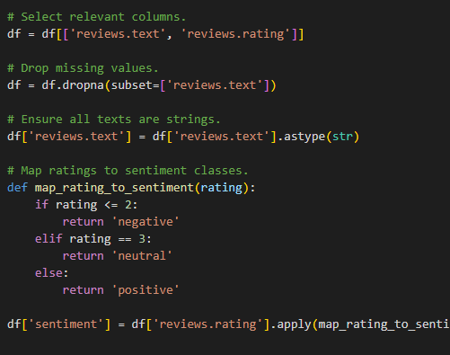
Data Mapping: similar step were taken for all 3 text classification models.
missing values can have a negative impact on the performance of machine learning models, as they can introduce bias and reduce the quality of the insights derived from the data.
maps review ratings to sentiment classes (negative, neutral, positive).
The ratings in the database were converted into sentiments to create the classes ‘negative’ (1/2 stars), ‘neutral’ (3 stars) and ‘positive’ (4/5 stars).

Slide 6
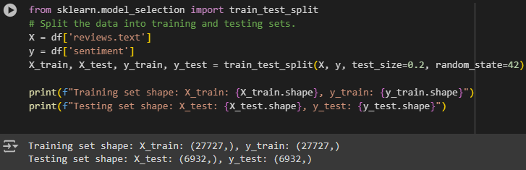
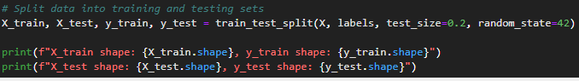
Data splitting: similar step were taken for all 3 text classification models.
Data splitting is a crucial step in the machine learning process, as it helps to ensure the reliability and generalizability of the model.
By dividing your dataset into distinct training, validation, and test sets, you can effectively train, tune, and evaluate your model's performance.
This approach prevents overfitting, allows you to optimize your model's hyperparameters, and provides an unbiased estimation of its real-world performance, ultimately leading to more robust and reliable machine learning models.

Slide 7
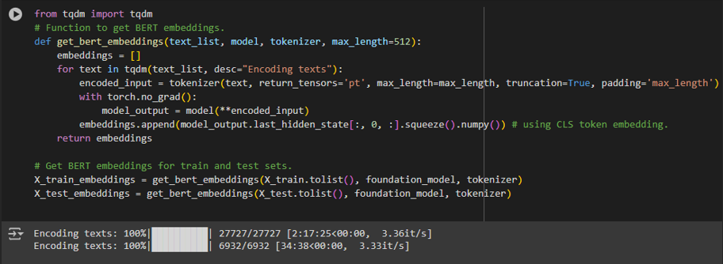
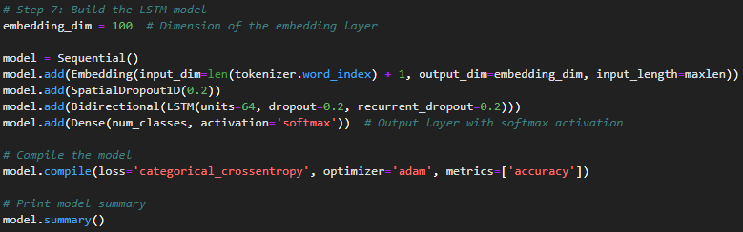
Text Embedding:
Transformer model: Takes a list of texts, a pre-trained BERT model, and a BERT tokenizer, and returns a list of BERT embeddings for each text. Defines a function to generate BERT embeddings for a list of text inputs, and then uses that function to generate BERT embeddings for the training and test sets, storing the results in the variables X_train_embeddings and X_test_embeddings, respectively.
NLP Model: Vectorization: This term highlights the fact that the text is being converted into numerical vectors, which is the typical output of the embedding phase.
Ser2Seq Model: sets up a neural network model with an embedding layer that learns a 100-dimensional numerical representation for each word in the input text, followed by a Bidirectional LSTM layer and a final Dense layer with a softmax activation for a multi-class classification task.

Slide 8
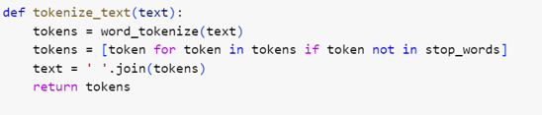
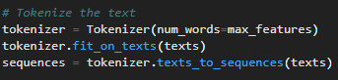
Text Tokenization: similar step were taken for all 3 text classification models.
the text was tokenized in order to breaks down text into smaller units like words or phrases, making it easier to analyse and process.
Preserving the structure of the text
Handling special characters and punctuation: Tokenizers often need to decide how to handle special characters, punctuation, and other non-alphabetic symbols, whether to include them as separate tokens or to remove them.
Notes:
2, Preserving the structure of the text: Tokenization should preserve the original structure of the text, such as sentence boundaries, paragraphs, and other relevant units.
Extra: Dealing with contractions and compound words: Tokenizers may need to handle contractions ("don't" -> "do" and "not") and compound words ("New York" -> "New" and "York").

Slide 9
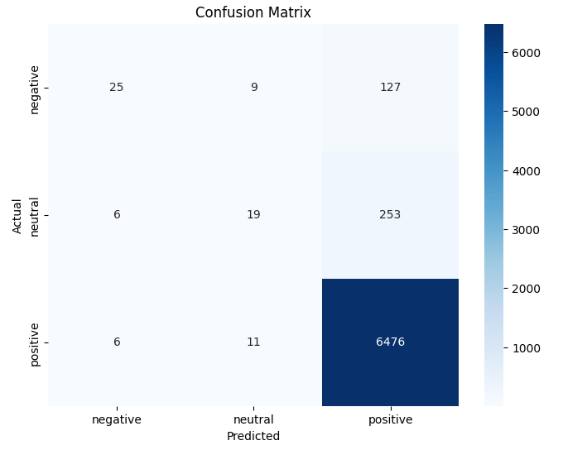
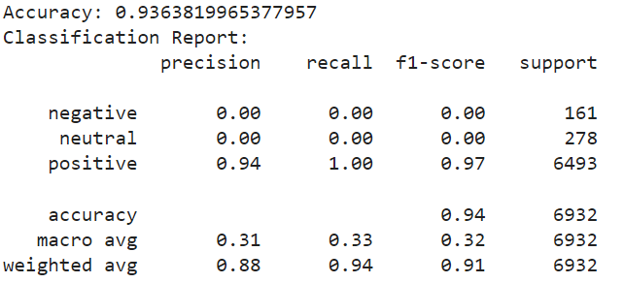
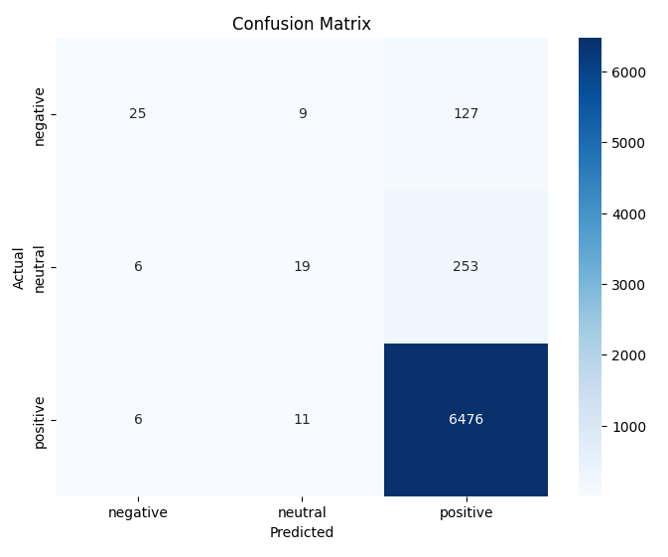
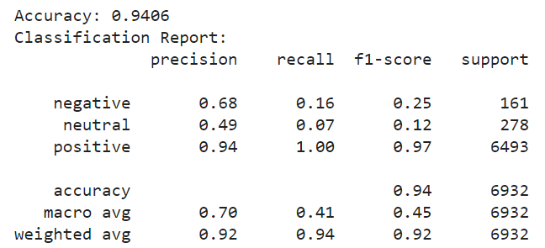
Model training and Evaluation:
NLP model was trained and evaluate on 3 different method,
Naive Bayes This model was explored first, as it is computationally efficient and often provides strong baseline performance for text classification problems.
Logistic Regression Secondly, a logistic regression model was trialed, this is for its simplicity, interpretability, and ability to output probabilities, making it effective for tasks such as this sentiment analysis
Random Forest Multiple variations of random forest were tested to try and improve the model’s performance with the minority classes. Base model was first tried, which showed improvements on the precision, however still very low recall and f1 scores for negative and neutral

Slide 10
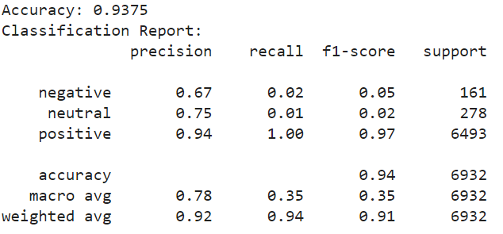
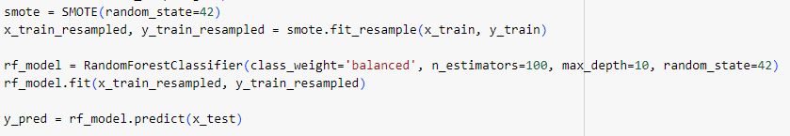
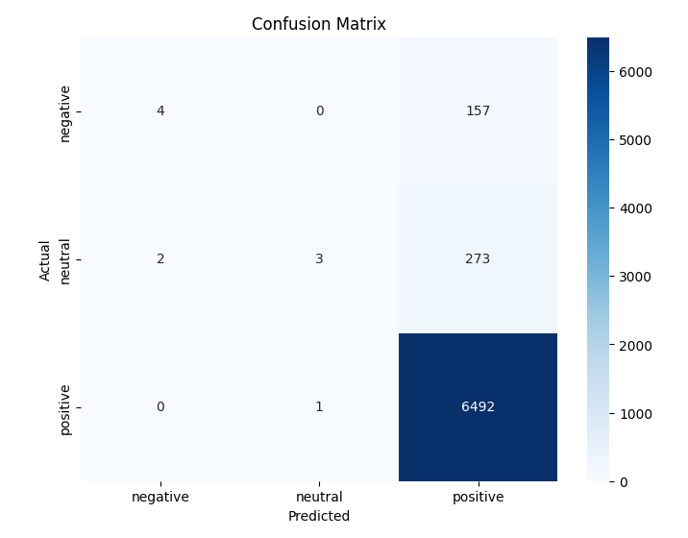

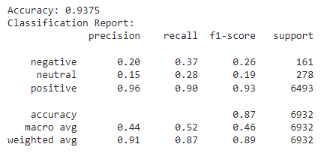
Random Forest
Next, we experimented with using synthetic sampling. SMOTE (Synthetic Minority Over-sampling Technique) is used to address class imbalance by generating synthetic samples for the minority classes of negative and neutral in the training data. This resampled data is then used to train a Random Forest with balanced class weights to mitigate the effects of the imbalance
Next, we experimented with using synthetic sampling. SMOTE (Synthetic Minority Over-sampling Technique) is used to address class imbalance by generating synthetic samples for the minority classes of negative and neutral in the training data. This resampled data is then used to train a Random Forest with balanced class weights to mitigate the effects of the imbalance.

Slide 11
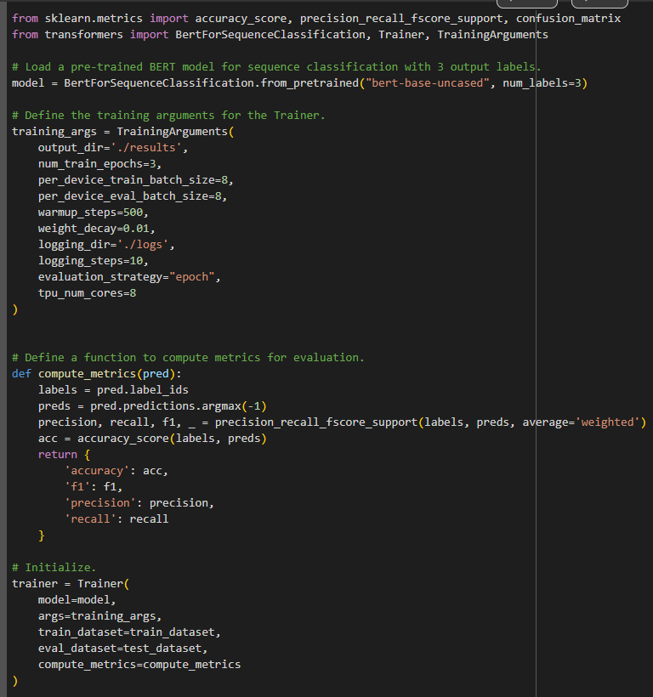
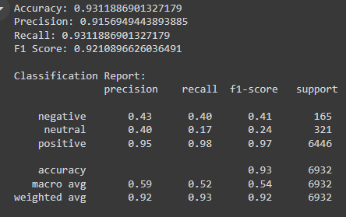
Transformer:
The ‘num_labels’ parameter in the ‘BertForSequenceClassification.from_pretrained()’ function is used to specify the number of output classes (labels) for the classification task, in our case (Positive, Neutral, Negative)
Define the training argument such as output_dir to specifies the directory where the model checkpoints and other output files will be saved during training.
Warmup_steps to sets the number of warmup steps for the learning rate scheduler, which helps stabilize the training process at the beginning.
Weight_dicay to sets the weight decay factor, which is a form of regularization that helps prevent overfitting.
Logging_steps to sets the frequency (in steps) at which logs will be written during training.
Using BERT for such a task got already high result without fine-tuning, but not for all 3 classes.
Bare model result:

Slide 12
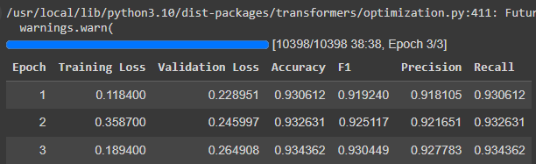
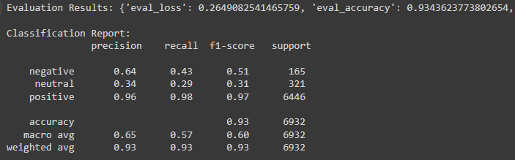
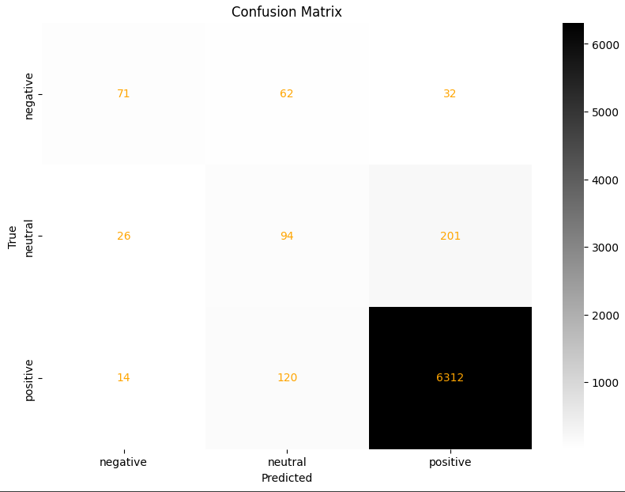
Fine-Tuning the model made slightly improvement in terms of compute metrics
The model was trained with different learning rates between 5e-1 (0.5) and 5e-5 (0.00005), but strangely got lower results than the base model. So warmup_steps was our best shot to get a bit higher result.

Slide 13
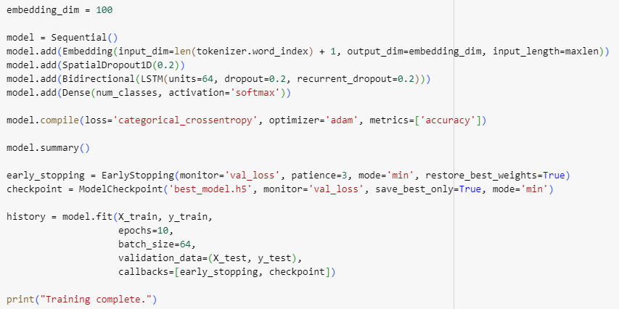
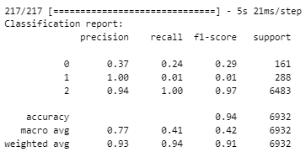
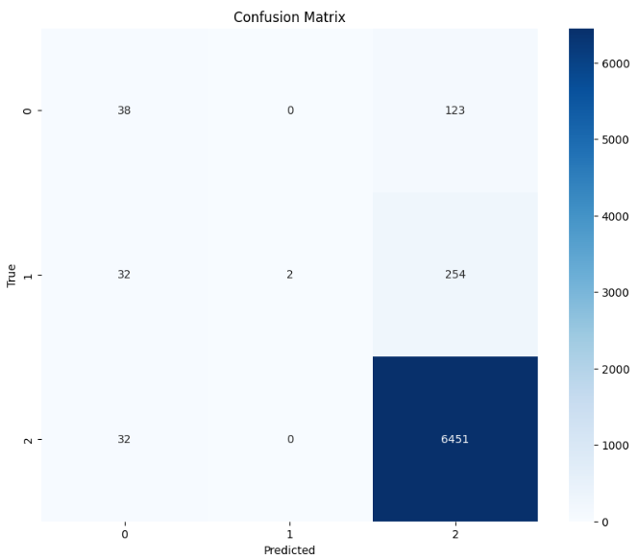
Seq2Seq:
Trained across multiple epochs with early stopping to prevent overfitting. Evaluated using accuracy metrics and visualized using confusion matrix and classification report.

Slide 14
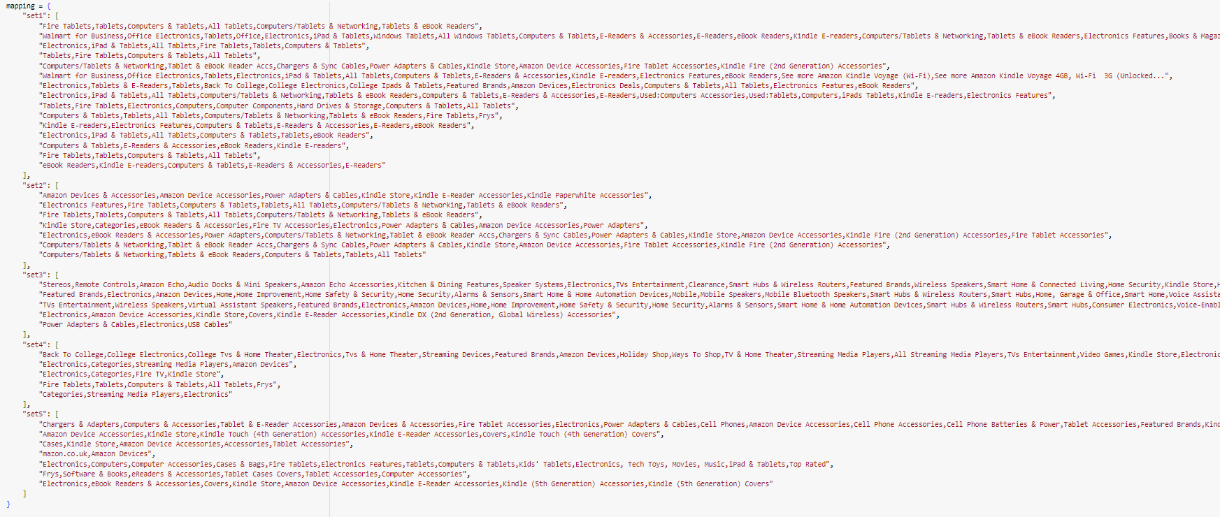
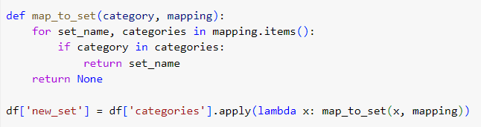
Summarization Model:
A summarization model was created in order to create summaries for predetermined sets by each review star.
To summarize the 34,000 reviews that span over 41 categories sets would need to be determined. As summarising per 41 categories for each star rating would result in over 200 summaries, diminishing the usefulness.
The categories were grouped by their similarities, into 5 separate sets.
The mapping was used to add a new column into the dataframe with the set names in. And all reviews that did not have a review or a star were dropped.

Slide 15
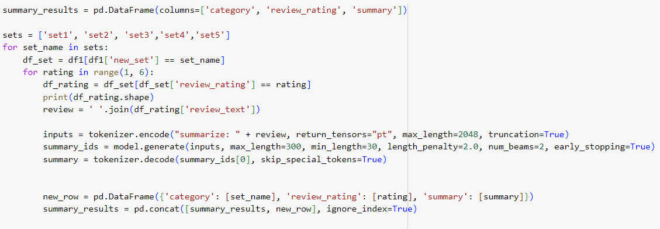
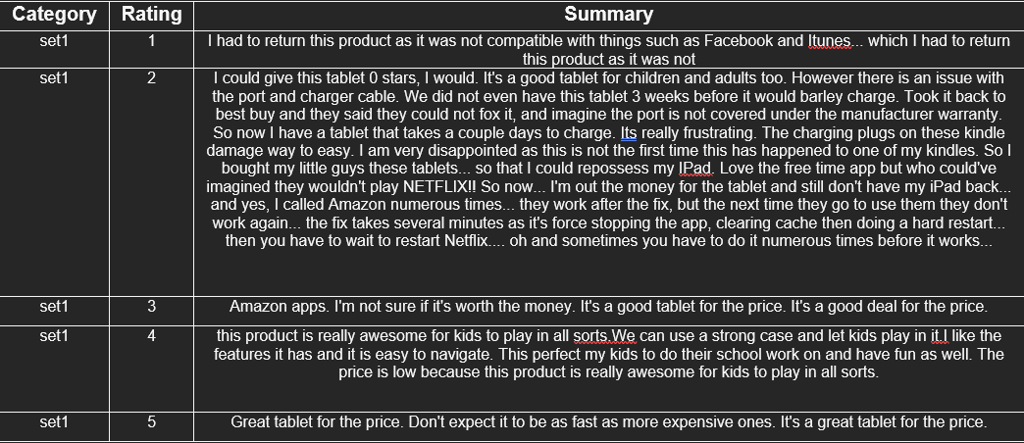
The transformer selected for this summarisation was Flan-T5-Large.
FLAN-T5-large model is useful for summarization because it is a transformer-based model that has been fine-tuned on a diverse set of language tasks, including summarization.
It leverages the capabilities of the T5 (Text-To-Text Transfer Transformer) architecture, which is designed to handle various NLP tasks by converting them into a text-to-text format.
This allows the model to generate high-quality summaries by understanding and condensing the input text effectively.
Additionally, its large size provides a higher capacity to capture and generate more nuanced and accurate summaries.

Slide 16



Slide 17
